Slide 1
University of Diyala College of Engineering Department of Communications Engineering
Satellite Communications
By:
Dr. Majidah Hameed Majeed

Slide 2
Lecture # 10

Slide 3
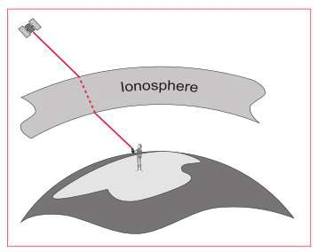
4.8 Error Sources
Up until this point, it has been assumed that the position derived from GPS is very accurate and free of error, but there are several sources of error that degrade the GPS
position from a theoretical few meters to tens of meters. These error sources are:
Ionospheric and atmospheric delays
Satellite and Receiver Clock Errors
Multipath
Dilution of Precision
Selective Availability (S/A)
Anti Spoofing (A-S)
4.8.1. Ionospheric and Atmospheric delays
As the satellite signal passes through the ionosphere, it can be slowed down, the effect being similar to light refracted through a glass block. These atmospheric delays can
introduce an error in the range calculation as the velocity of the signal is affected.
(Light only has a constant velocity in a vacuum). The ionosphere does not introduce a constant delay on the signal. There are several factors that influence the amount of
delay caused by the ionosphere.

Slide 4
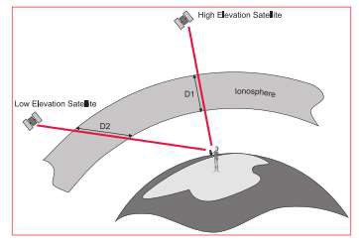
Satellite elevation.
Signals from low elevation satellites will be affected more than signals from higher elevation satellites. This is due to the increased distance that the signal passes through
the atmosphere.
The density of the ionosphere is affected by the sun
At night, there is very little ionospheric influence. In the day, the sun increases the effect of the ionosphere and slows down the signal. The amount by which the density
of the ionosphere is increased varies with solar cycles (sunspot activity). Sunspot activity peaks approximately every 11 years. At the time of writing, the next peak
(solar next peak (solar max) will be around the year 2000. In addition to this, solar flares can also randomly occur and also have an effect on the ionosphere. Ionospheric
errors can be mitigated
by using one of two methods:
- The first method involves taking an average of the effect of the reduction in velocity of light caused by the ionosphere. This correction factor can then be applied to the range calculations. However, this relies on an average and obviously this
4.8.4 The density of the ionosphere is affected by the sun.

Slide 5
At night, there is very little ionospheric influence. In the day, the sun increases the effect of the ionosphere and slows down the signal. average condition does not occur all of the time. This method is therefore not the optimum solution to Ionospheric Error mitigation.
- The second method involves using “dual-frequency” GPS receivers. Such receivers measure the L1 and the L2 frequencies of the GPS signal. It is known that when a radio signal travels through the ionosphere it slows down at a rate inversely proportional to it’s frequency. Hence, if the arrival times of the two signals are compared, an accurate estimation of the delay can be made. Note that this is only possible with dual frequency GPS receivers. Most receivers built for navigation are single frequency.
Water Vapour also affects the GPS signal. Water vapor contained in the atmosphere can also affect the GPS signal. This effect, which can result in a position
degradation can be reduced by using atmospheric models.
Satellite and Receiver clock errors
Even though the clocks in the satellite are very accurate (to about 3 nanoseconds), they do sometimes drift slightly and cause small errors, affecting the accuracy of the
position. The US Department of Defense monitors the satellite clocks using the Control
Segment (see section 2.2) and can correct any drift that is found.
Multipath Errors
Multipath occurs when the receiver antenna is positioned close to a large reflecting surface such as a lake or building. The satellite signal does not travel directly to the
antenna but hits the nearby object first and is reflected into the antenna creating a false
measurement. Multipath can be reduced by use of special GPS antennas that incorporate a ground plane (a circular,

Slide 6
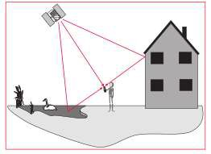
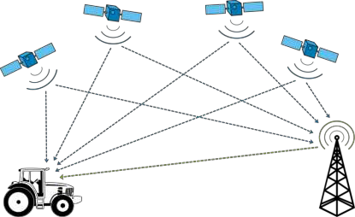
Metallic disk about 50cm (2 feet) in diameter) that prevent low elevation Signals reaching the antenna.
For highest accuracy, the preferred solution is use of a choke ring antenna. A choke ring antenna has 4 or 5 concentric rings around the antenna that trap any indirect signals. Multipath only affects high accuracy, surveytype
measurements. Simple handheld navigation receivers do not employ such techniques.
4.9 Differentially corrected positions (DGPS)
Many of the errors affecting the measurement of satellite range can be completely eliminated or at least significantly reduced using differential measurement techniques.
DGPS allows the civilian user to increase position accuracy from 100m to 2-3m or less, making it more useful for many civilian applications.
Unknown Position
reference transmitters
Known
receiver and

Slide 7
position
The Reference receiver antenna is mounted on a previously measured
point with known coordinates. The receiver that is set at this point is known
as the Reference Receiver or Base Station. The receiver is switched on and begins to track satellites.
Because it is on a known point, the reference receiver can estimate very
precisely what the ranges to the various satellites should be.
The reference receiver can therefore work out the difference between the
computed and measured range values. These differences are known as corrections. The reference receiver is usually attached to a radio data link which is used to broadcast these corrections.
20

